Slide 1

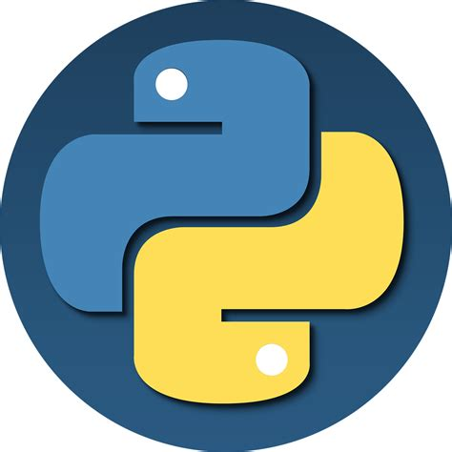
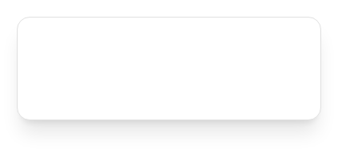

Intro to Python And ADS
Why Python Is One of the Most Popular Programming Languages?
Course Instructor
Samandar Gofurjonov

Slide 2





Catalog
01
Python at a Glance
05
Performance & Ecosystem
02
Design Philosophy
06
Where Python Is Used
03
Why Python Is Popular
07
Strengths & Learnability
04
From Scripting to Applications
08
Programming Paradigms
Python Programming Course
02

Slide 3



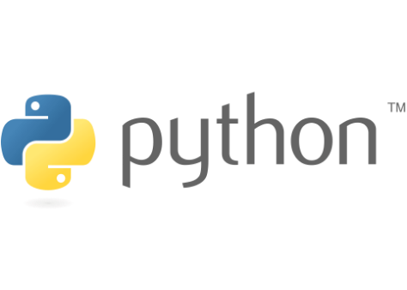

What Is Python?
General-purpose programming language
Used to build many types of software
Supports multiple styles:
Object-oriented programming
Procedural programming
Functional programming
Main Goal
Simplify and speed up software development
Python Programming Course
03

Slide 4


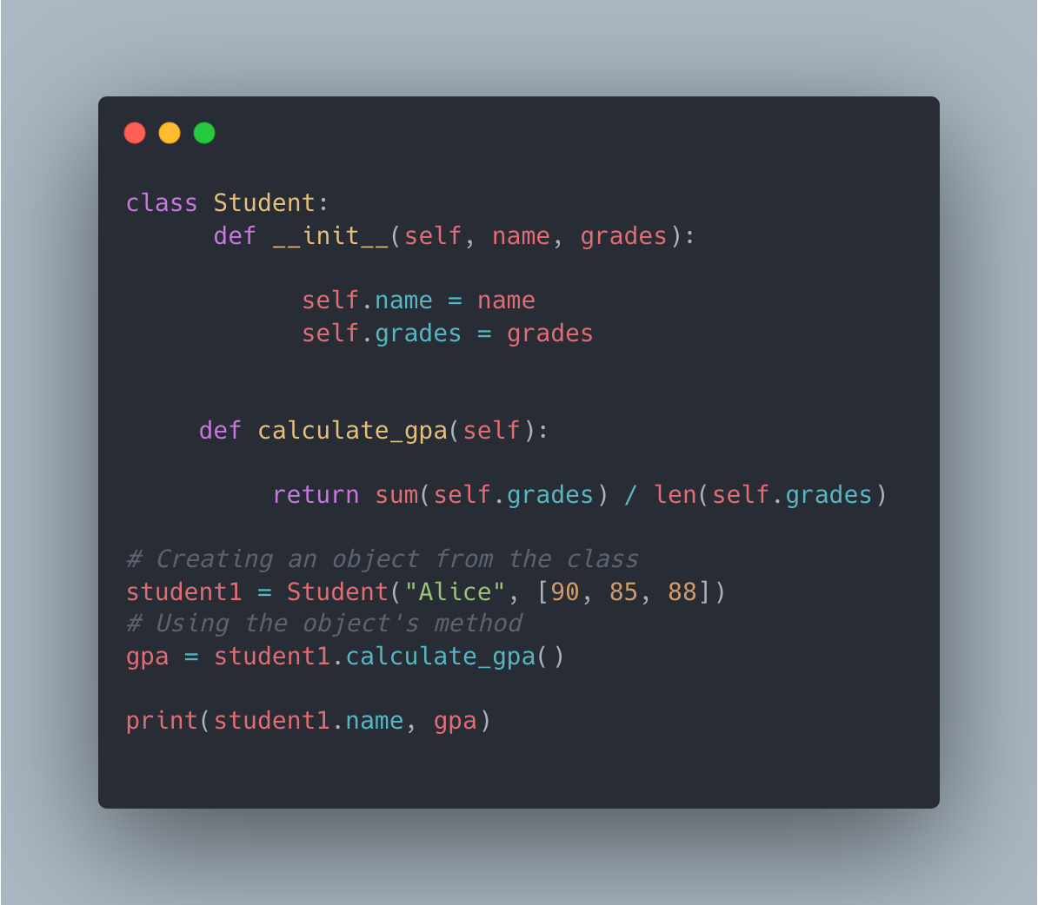

Object-Oriented Programming (OOP) in Python
Concept
python
Example code:
Programs built using classes and objects (a class is a blueprint; an object is an instance)
class Student:
def __init__(self, name, grades):
self.name = name
self.grades = grades
def calculate_gpa(self):
return sum(self.grades) / len(self.grades)
# Creating an object from the class
student1 = Student("Alice", [90, 85, 88])
# Using the object's method
gpa = student1.calculate_gpa()
print(student1.name, gpa)
class Student: def __init__(self, name, grades): self.name = name self.grades = grades def calculate_gpa(self): return sum(self.grades) / len(self.grades) # Creating an object from the class student1 = Student("Alice", [90, 85, 88]) # Using the object's method gpa = student1.calculate_gpa() print(student1.name, gpa)
Key Idea (Kicker)
Group related data and behavior together
Core OOP Concepts:
Explanation:
Classes
Student → class (blueprint)
Objects
student1 → object (instance)
Encapsulation
Inheritance
Polymorphism

Slide 5

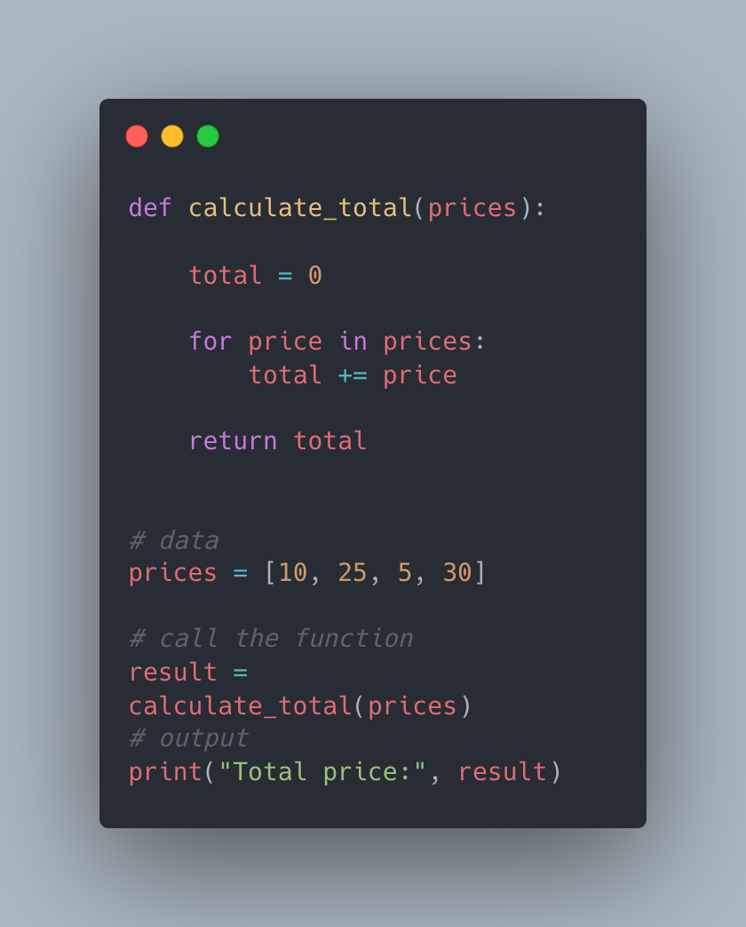

Procedural Programming in Python
Example code:
Concept
Writing code as a sequence of instructions executed step by step; organized into functions that perform specific tasks
Key Idea (Kicker)
Clear top-to-bottom flow of execution
Best Used For:
Small scripts
Automation tasks
Common Python Features:
Simple programs
Functions (def)
Beginner-friendly projects
Loops (for, while)
Conditional statements (if, elif, else)
Python Programming Course
5

Slide 6

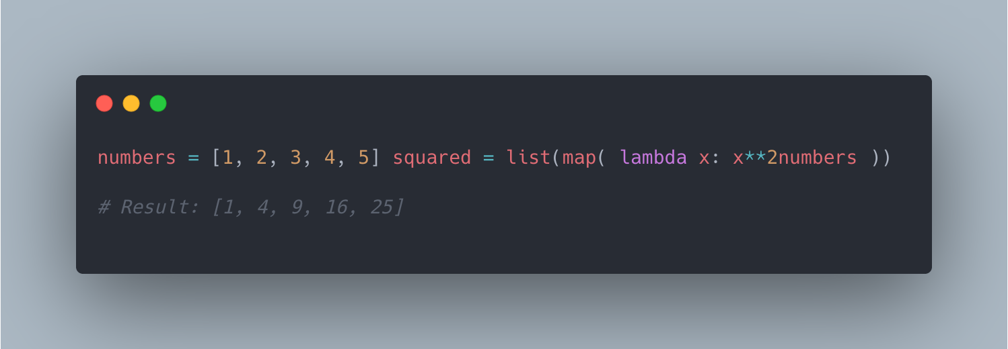

Functional Programming in Python
Concept
Example Code
Functions used to transform data; often avoids modifying existing data and returns new results. Use small functions to process and transform data.
Key Idea
"Take data, transform it, return the result"
Common Tools
Best Used For
map()
Data processing
filter()
Working with collections
lambda functions
Cleaner transformations
List comprehensions

Slide 7



Python Design Philosophy
Programs should be easy to understand
Simple is better than complex
Readable code is important
Encourages clean and maintainable code
Avoid unnecessary complications in logic and structure
Clarity in intent makes collaboration and debugging seamless
Code is read much more often than it is written
Focus on long-term sustainability of the codebase
Python Programming Course
07

Slide 8

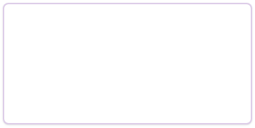






Why Is Python So Popular?
Six key reasons:
Software quality
Developer productivity
Program portability
Large standard library
Component integration
Easy and enjoyable to use
Python Programming Course
08

Slide 9

Software Quality
Clear and readable syntax
Easier maintenance
Reusable code
Supports modular programming
Strong support for object-oriented programming
Python Programming Course
09

Slide 10

Developer Productivity
Less code than C++ or Java
No compilation step required
Faster testing and debugging
Dynamic typing simplifies development
Python Programming Course
10

Slide 11

Python Is More Than a Scripting Language
Used for small automation scripts
Used for large applications
System tasks
Web platforms and AI systems
Data processing
Scientific and enterprise software
Python Programming Course
11

Slide 12


What Is a Scripting Language?
Definition
Programming language used to automate tasks
Often used to control other software
Examples:
Executes instructions quickly
File processing
Automation
Running system tasks

Slide 13

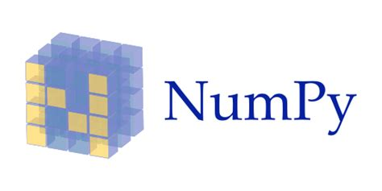
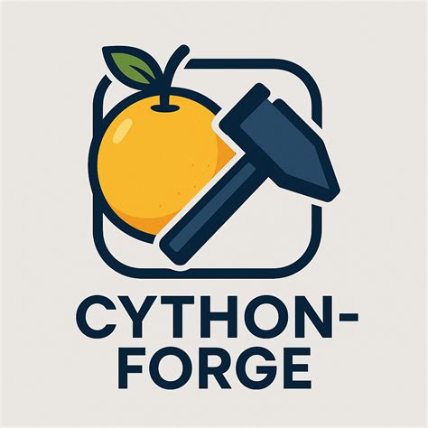
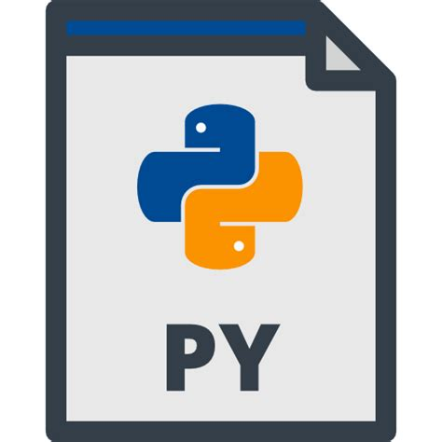

The Trade-off: Performance
Python can be slower than compiled languages like C or C++
Usually fast enough for most applications
Many operations run in optimized C code
Performance tools:
PyPy
Cython
NumPy
Python Programming Course
13

Slide 14

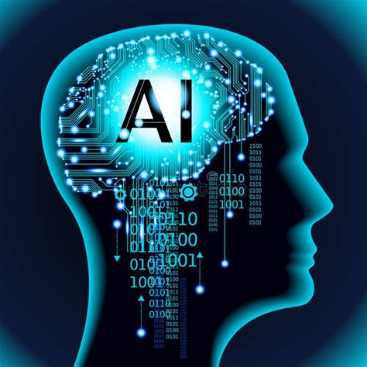
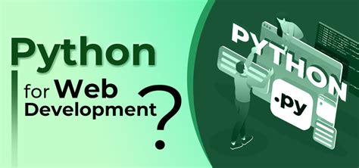
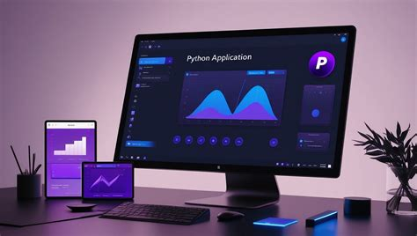
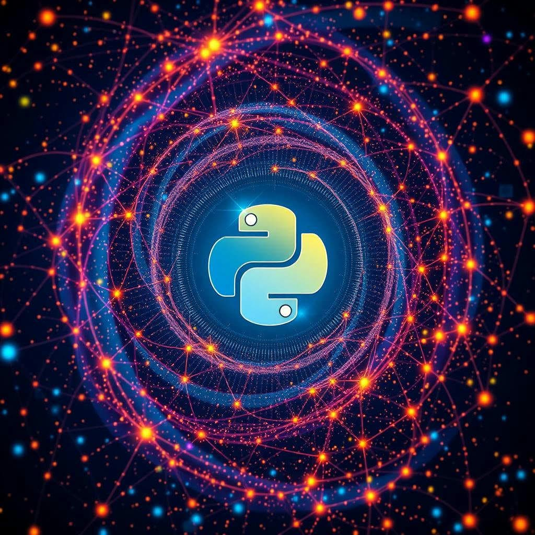
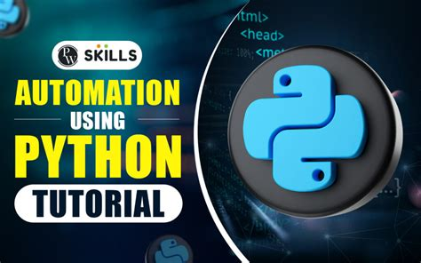
What Can You Do With Python?
Data Science and AI
Web Development
GUI Applications
Automation and Systems Programming
Scientific Computing
Python Programming Course
14

Slide 15

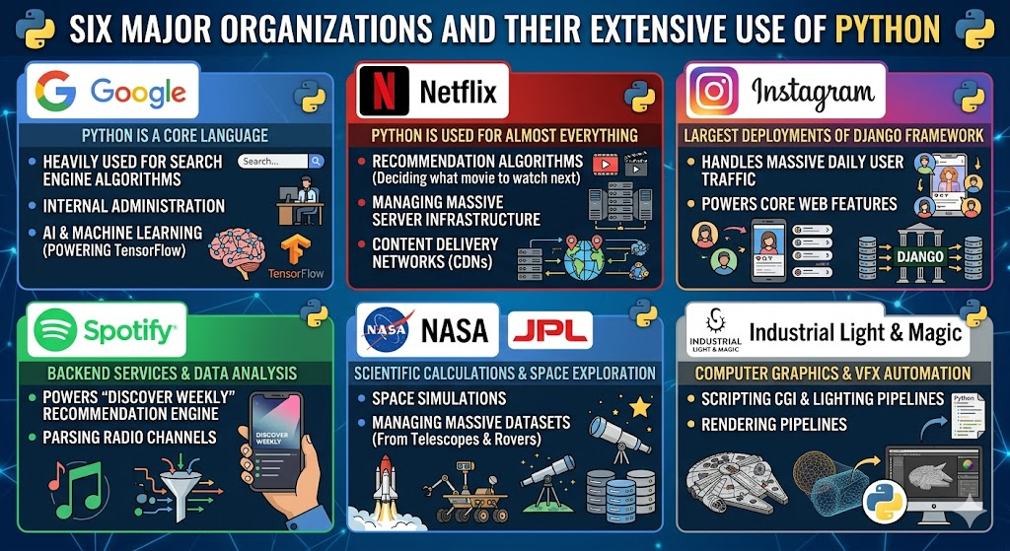
Companies That Use Python
Technology companies, science and engineering, finance and media
Google, NASA, JP Morgan
Microsoft, Intel, Disney
Instagram, Netflix, Spotify
One of the most widely used languages worldwide
Python Programming Course
15

Slide 16

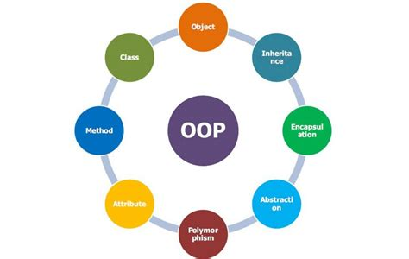
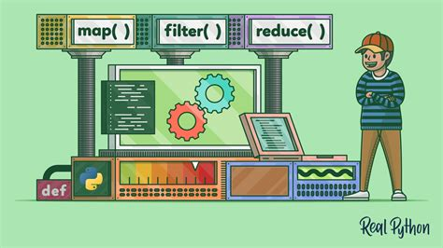
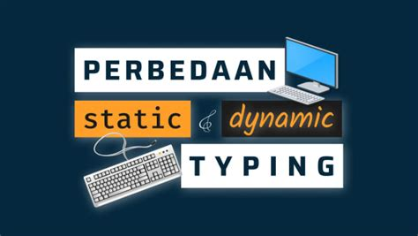
Technical Strengths of Python (1)
Object-Oriented Programming support
Functional Programming support
Dynamic typing
Supports classes and objects for modular and reusable code structures
Includes features like lambda, map, and filter for functional paradigms
Variables are bound to objects at runtime, increasing development flexibility
Python Programming Course
16

Slide 17







Technical Strengths of Python (2)
Automatic memory management
Garbage collection handles memory allocation and deallocation automatically
Large standard library
Extensive built-in modules for everything from I/O to network programming
Cross-platform compatibility
Code runs seamlessly across Windows, macOS, and Linux environments
Python Programming Course
17

Slide 18

Why Python Is Easy to Learn
Simple and readable syntax
Fewer lines of code
Interactive programming
Strong community support
Great for beginners and professionals
Python Programming Course
18

Slide 19





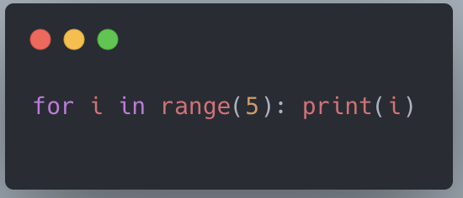
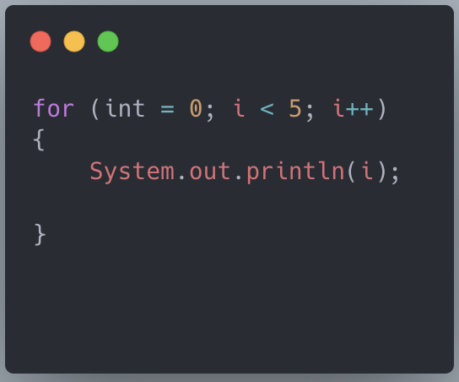
Python vs Other Languages
Python programs are shorter and easier to read
Python improves development speed
Better readability for teams
Java
print
Python
Java
VS

Slide 20
Thank You
Questions?

